Slide 1
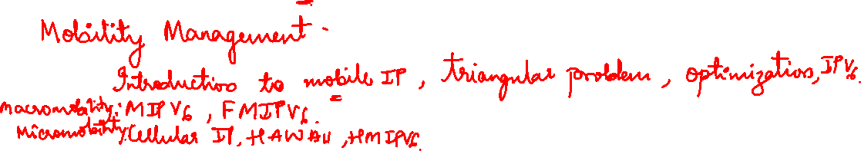
Module 5

Slide 2

Overview
COA
foreign
network
home
network
router
HA
router
FA
MN
Internet
CN
router
3.
foreign
network
home
network
router
HA
router
FA
MN
2.
4.
Internet
1.
CN
router

Slide 3
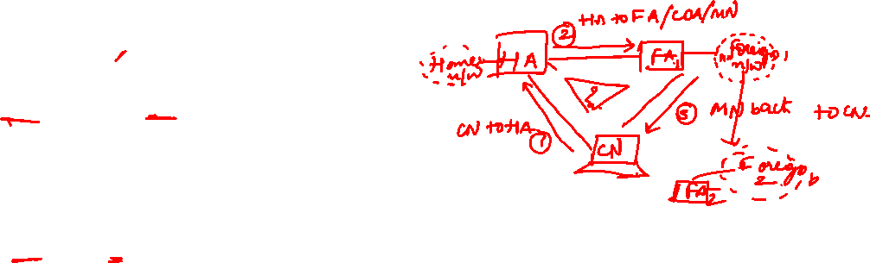
Optimization of packet forwarding
Triangular Routing
sender sends all packets via HA to MN
higher latency and network load
“Solutions”
sender learns the current location of MN
direct tunneling to this location
HA informs a sender about the location of MN
big security problems!
Change of FA
packets on-the-fly during the change can be lost
new FA informs old FA to avoid packet loss, old FA now forwards remaining packets to new FA
this information also enables the old FA to release resources for the MN

Slide 4
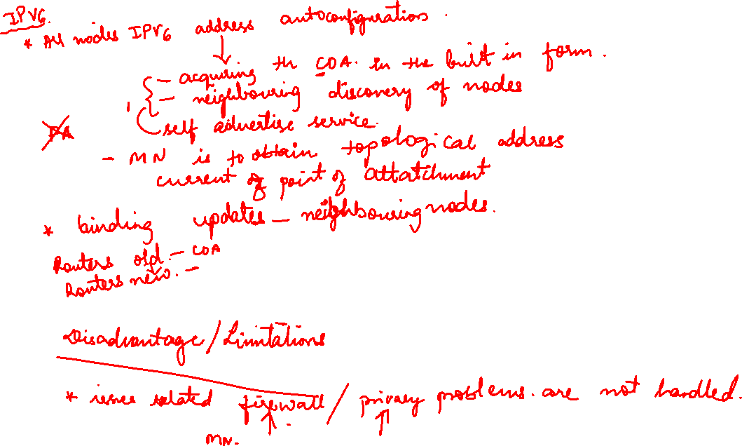

Slide 5
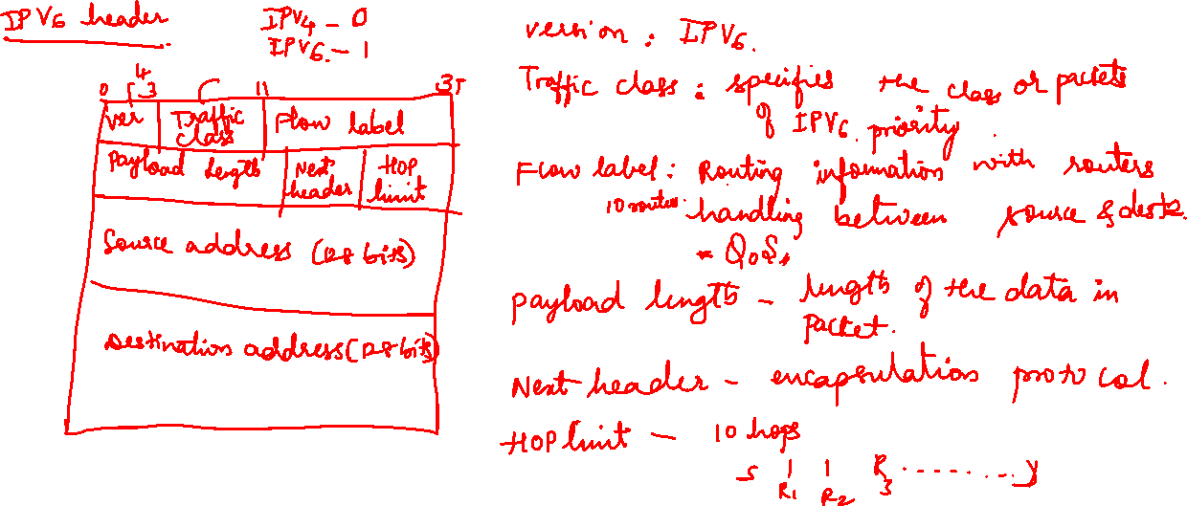

Slide 6
Change of foreign agent
CN
HA
FA_{old}
FA_{new}
MN
Data
Data
Data
Update
ACK
Data
Data
MN changes location
Update
Registration
ACK
Data
Data
Data
Warning
Request
Update
ACK
Data
Data
t

Slide 7


Mobile IP and IPv6
Mobile IP was developed for IPv4, but IPv6 simplifies the protocols
security is integrated and not an add-on, authentication of registration is included
COA can be assigned via auto-configuration (DHCPv6 is one candidate), every node has address autoconfiguration
no need for a separate FA, all routers perform router advertisement which can be used instead of the special agent advertisement; addresses are always co-located
MN can signal a sender directly the COA, sending via HA not needed in this case (automatic path optimization)
„soft“ hand-over, i.e. without packet loss, between two subnets is supported
MN sends the new COA to its old router
the old router encapsulates all incoming packets for the MN and forwards them to the new COA
authentication is always granted

Slide 8
IP Micro-mobility support
Micro-mobility support:
Efficient local handover inside a foreign domain without involving a home agent
Reduces control traffic on backbone
Especially needed in case of route optimization
Example approaches:
Cellular IP
HAWAII
Hierarchical Mobile IP (HMIP)
Important criteria: Security Efficiency, Scalability, Transparency, Manageability

Slide 9
Cellular IP
Operation:
„CIP Nodes“ maintain routing entries (soft state) for MNs
Multiple entries possible
Routing entries updated based on packets sent by MN
CIP Gateway:
Mobile IP tunnel endpoint
Initial registration processing
Security provisions:
all CIP Nodes share „network key“
MN key: MD5(net key, IP addr)
MN gets key upon registration
Internet
Mobile IP
CIP Gateway
data/control
packets
from MN 1
BS
BS
BS
packets from
MN2 to MN 1
MN1
MN2

Slide 10
Cellular IP: Security
Advantages:
Initial registration involves authentication of MNs and is processed centrally by CIP Gateway
All control messages by MNs are authenticated
Replay-protection (using timestamps)
Potential problems:
MNs can directly influence routing entries
Network key known to many entities (increases risk of compromise)
No re-keying mechanisms for network key
No choice of algorithm (always MD5, prefix+suffix mode)
Proprietary mechanisms (not, e.g., IPSec AH)

Slide 11
Cellular IP: Other issues
Advantages:
Simple and elegant architecture
Mostly self-configuring (little management needed)
Integration with firewalls / private address support possible
Potential problems:
Not transparent to MNs (additional control messages)
Public-key encryption of MN keys may be a problem for resource-constrained MNs
Multiple-path forwarding may cause inefficient use of available bandwidth

Slide 12
HAWAII (Handoff Aware Wireless Access Internet Infrastructure)
Operation:
MN obtains co-located COA and registers with HA
Handover: MN keeps COA, new BS answers Reg. Request and updates routers
MN views BS as foreign agent
Security provisions:
MN-FA authentication mandatory
Challenge/Response Extensions mandatory
1
Internet
2
HA
3
Backbone
Router
4
Crossover
Router
2
4
Mobile IP
BS
BS
BS
DHCP
Server
Mobile IP
3
MN
MN
DHCP
1

Slide 13
HAWAII: Security
Advantages:
Mutual authentication and C/R extensions mandatory
Only infrastructure components can influence routing entries
Potential problems:
Co-located COA raises DHCP security issues (DHCP has no strong authentication)
Decentralized security-critical functionality (Mobile IP registration processing during handover) in base stations
Authentication of HAWAII protocol messages unspecified (potential attackers: stationary nodes in foreign network)
MN authentication requires PKI (Public Key Infrastructure) or AAA infrastructure

Slide 14
HAWAII: Other issues
Advantages:
Mostly transparent to MNs (MN sends/receives standard Mobile IP messages)
Explicit support for dynamically assigned home addresses
Potential problems:
Mixture of co-located COA and FA concepts may not be supported by some MN implementations
No private address support possible because of co-located COA

Slide 15
Hierarchical Mobile IPv6 (HMIPv6)
Operation:
Network contains mobility anchor point (MAP)
mapping of regional COA (RCOA) to link COA (LCOA)
Upon handover, MN informs MAP only
gets new LCOA, keeps RCOA
HA is only contacted if MAP changes
AR(Access Router)- Default Router
Security provisions:
no HMIP-specific security provisions
binding updates should be authenticated
Internet
HA
RCOA
MAP
binding
update
AR
AR
LCOA_{new}
LCOA_{old}
MN
MN

Slide 16
Hierarchical Mobile IP: Security
Advantages:
Local COAs can be hidden, which provides some location privacy
Direct routing between CNs sharing the same link is possible (but might be dangerous)
Potential problems:
Decentralized security-critical functionality (handover processing) in mobility anchor points
MNs can (must!) directly influence routing entries via binding updates (authentication necessary)

Slide 17
Hierarchical Mobile IP: Other issues
Advantages:
Handover requires minimum number of overall changes to routing tables
Integration with firewalls / private address support possible
Potential problems:
Not transparent to MNs
Handover efficiency in wireless mobile scenarios:
Complex MN operations
All routing reconfiguration messages sent over wireless link

Slide 18

DHCP: Dynamic Host Configuration Protocol
Application
simplification of installation and maintenance of networked computers
supplies systems with all necessary information, such as IP address, DNS server address, domain name, subnet mask, default router etc.
enables automatic integration of systems into an Intranet or the Internet, can be used to acquire a COA for Mobile IP
Client/Server-Model
the client sends via a MAC broadcast a request to the DHCP server (might be via a DHCP relay)
DHCPDISCOVER
DHCPDISCOVER
server
client
client
relay

Slide 19
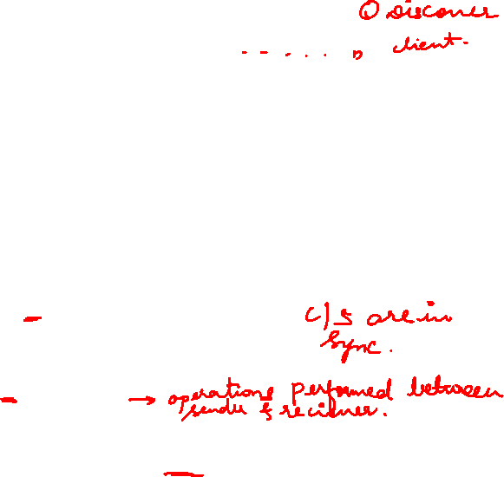
DHCP - protocol mechanisms
server
(not selected)
client
server
(selected)
initialization
determine the
configuration
DHCPDISCOVER
DHCPDISCOVER
determine the
configuration
DHCPOFFER
DHCPOFFER
collection of replies
time
selection of configuration
DHCPREQUEST (reject)
DHCPREQUEST (options)
confirmation of
configuration
DHCPACK
initialization completed
release
DHCPRELEASE
delete context

Slide 20
DHCP characteristics
Server
several servers can be configured for DHCP, coordination not yet standardized (i.e., manual configuration)
Renewal of configurations
IP addresses have to be requested periodically, simplified protocol
Options
available for routers, subnet mask, NTP (network time protocol) timeserver, SLP (service location protocol) directory, DNS (domain name system)
Big security problems!
no authentication of DHCP information specified

Slide 21
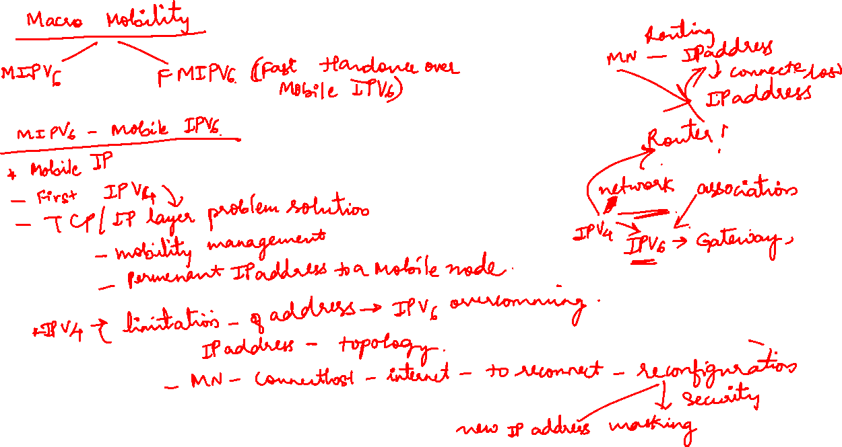

Slide 22
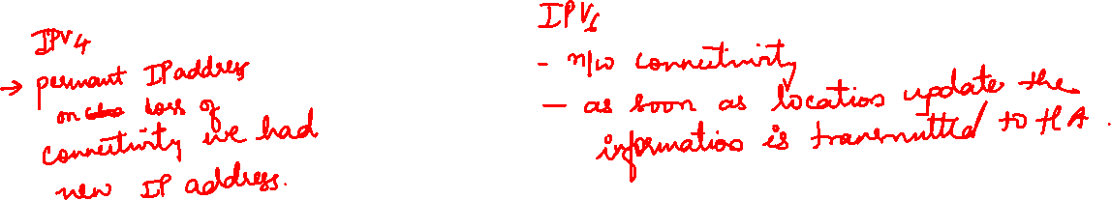

Slide 23
